Slide 1

Group 03’s Study Buddy
Anika Siddiqui Mayesha
Rumaysa Babulkhair
Yurii Sykal(Team Lead)
Lorenzo Palleschi

Slide 2
Agenda

Slide 5
What the Study Assistant Must Do

Slide 6


Slide 7
Basic Workflow

Slide 8
LLM APIs Comparision
OpenAI, Gemini, & other Cloud APIs | Local LLM (e.g., via Ollama/HuggingFace)
Model run entirely in the provider's cloud data center. | Pull model into your local machine/private server.
Easy to integrate | Moderate to High complexity
Costly | No cost (open-source models)
Don't depend on user's local hardware | Depends on hardware
Smart answers, fills knowledge gaps | Smart answers, fills knowledge gaps
Data is sent to a third-party server. | Data stays entirely on your private hardware.

Slide 9
Future work
Change frontend design to new version
1
Use Local LLM
2
Integrate Multimodal AI Capabilities
3

Slide 10
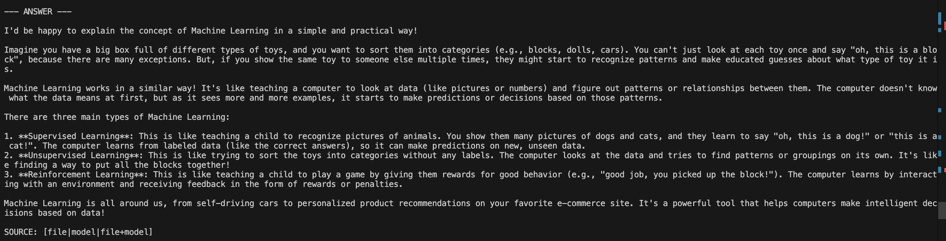
Ollama (in development)
Question :
Can you explain me the concept of machine learning in a very easy and practical way

Slide 12

Any Questions?

